Slide 1
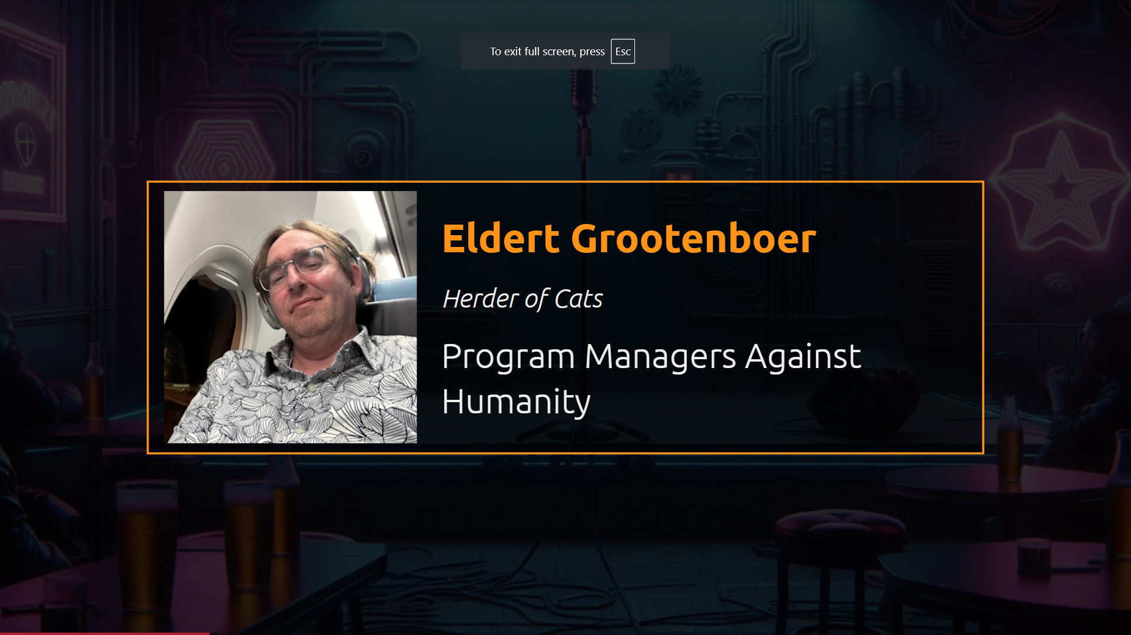

Slide 2
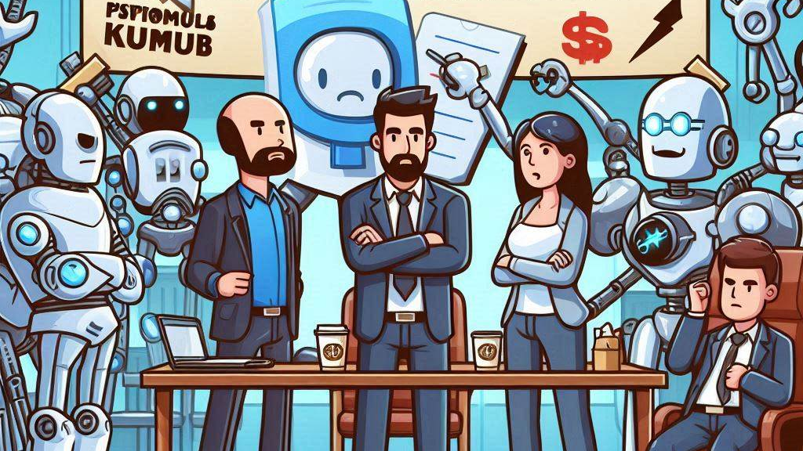
Product Managers against humanity
Notes:
When Lemon reached out to me to speak at PubConf, I though what any sensible person would think… Hell no I’m not going to do that! I’m already doing a session at KCDC! I don’t need the pressure of creating another new session!

Slide 3
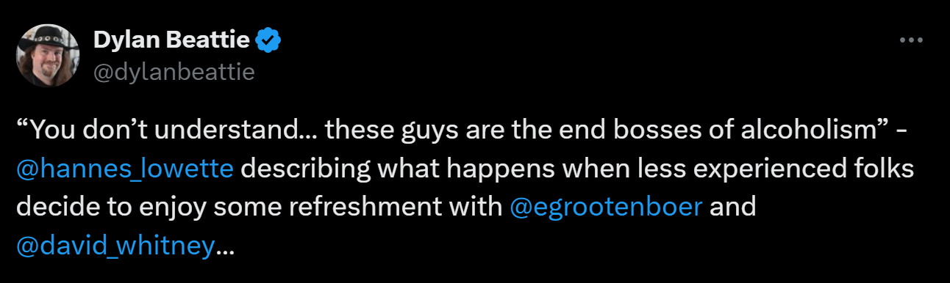
Notes:
But then, after having had a few drinks one evening… Yes, that one time I had a few drinks… Angelique convinced me to join, and as Todd has taught me, what you say when you are drunk, you have to do when you’re sober, that will teach me to keep my big mouth shut.

Slide 4

Notes:
So now here I was, thinking about Lemon’s proposed topic, what will our world look like in 2034. And so, I started thinking about what an ideal world would look like to me… A world where I don’t have to interact with people!

Slide 5
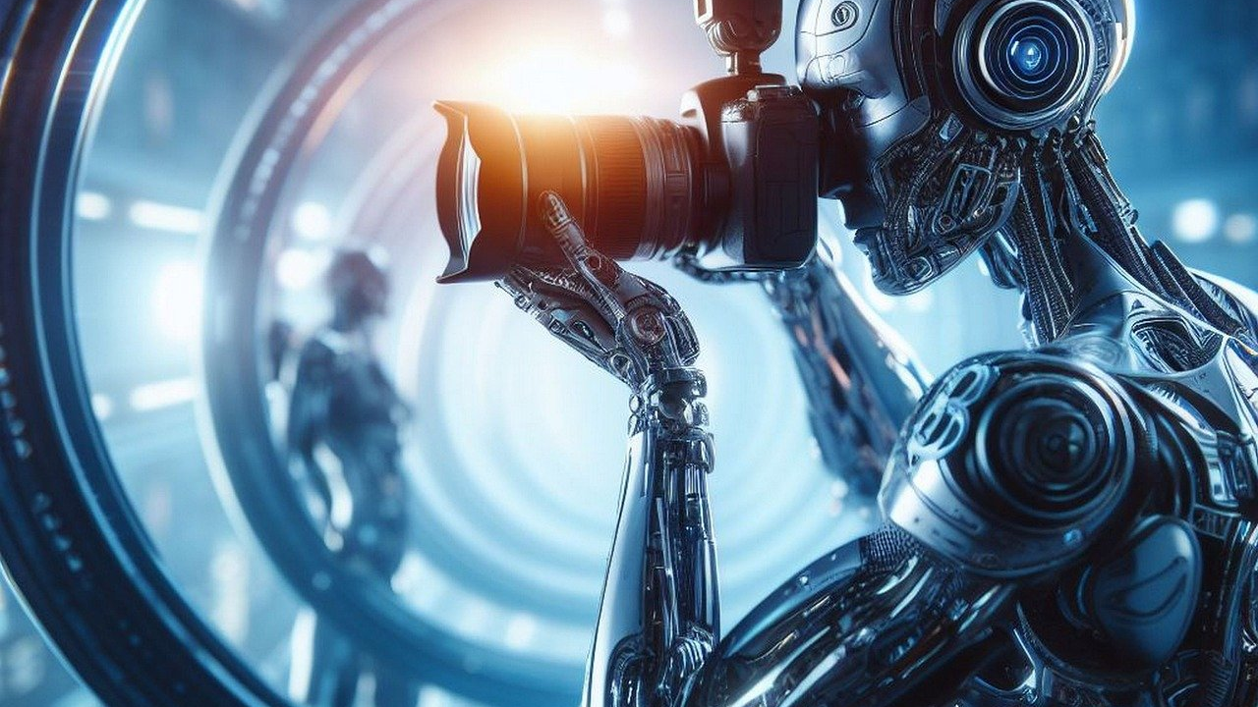
Notes:
Luckily, AI is about to take over the world! As some of you might know, I am the program manager for Azure Service Bus, at Microsoft, and not having to deal with people would make my life so much easier.

Slide 6

Notes:
First, I can finally get rid of our engineering team. Most of my day is making sure that they focus on building the features I want, instead of silly stuff… like making sure our service keeps running without any interruptions. Don’t they know I have GitHub issues to mark as “won’t close”?

Slide 7

Azure Service Bus
Notes:
I mean, all I’m asking is to build a distributed service, that can serve billions of request per month globally, with 99.99 SLA, no data loss, and keep adding new features to this. How hard can it be! By the way, another thing that Todd taught me… it’s okay to use PubConf to promote your products!

Slide 8

Notes:
And thanks to CoPilot, I can now just tell AI what I want to build, and it will automatically generate everything for me. And we all know that AI is infallible, so as a good program manager I can now push this directly into our production systems.

Slide 9
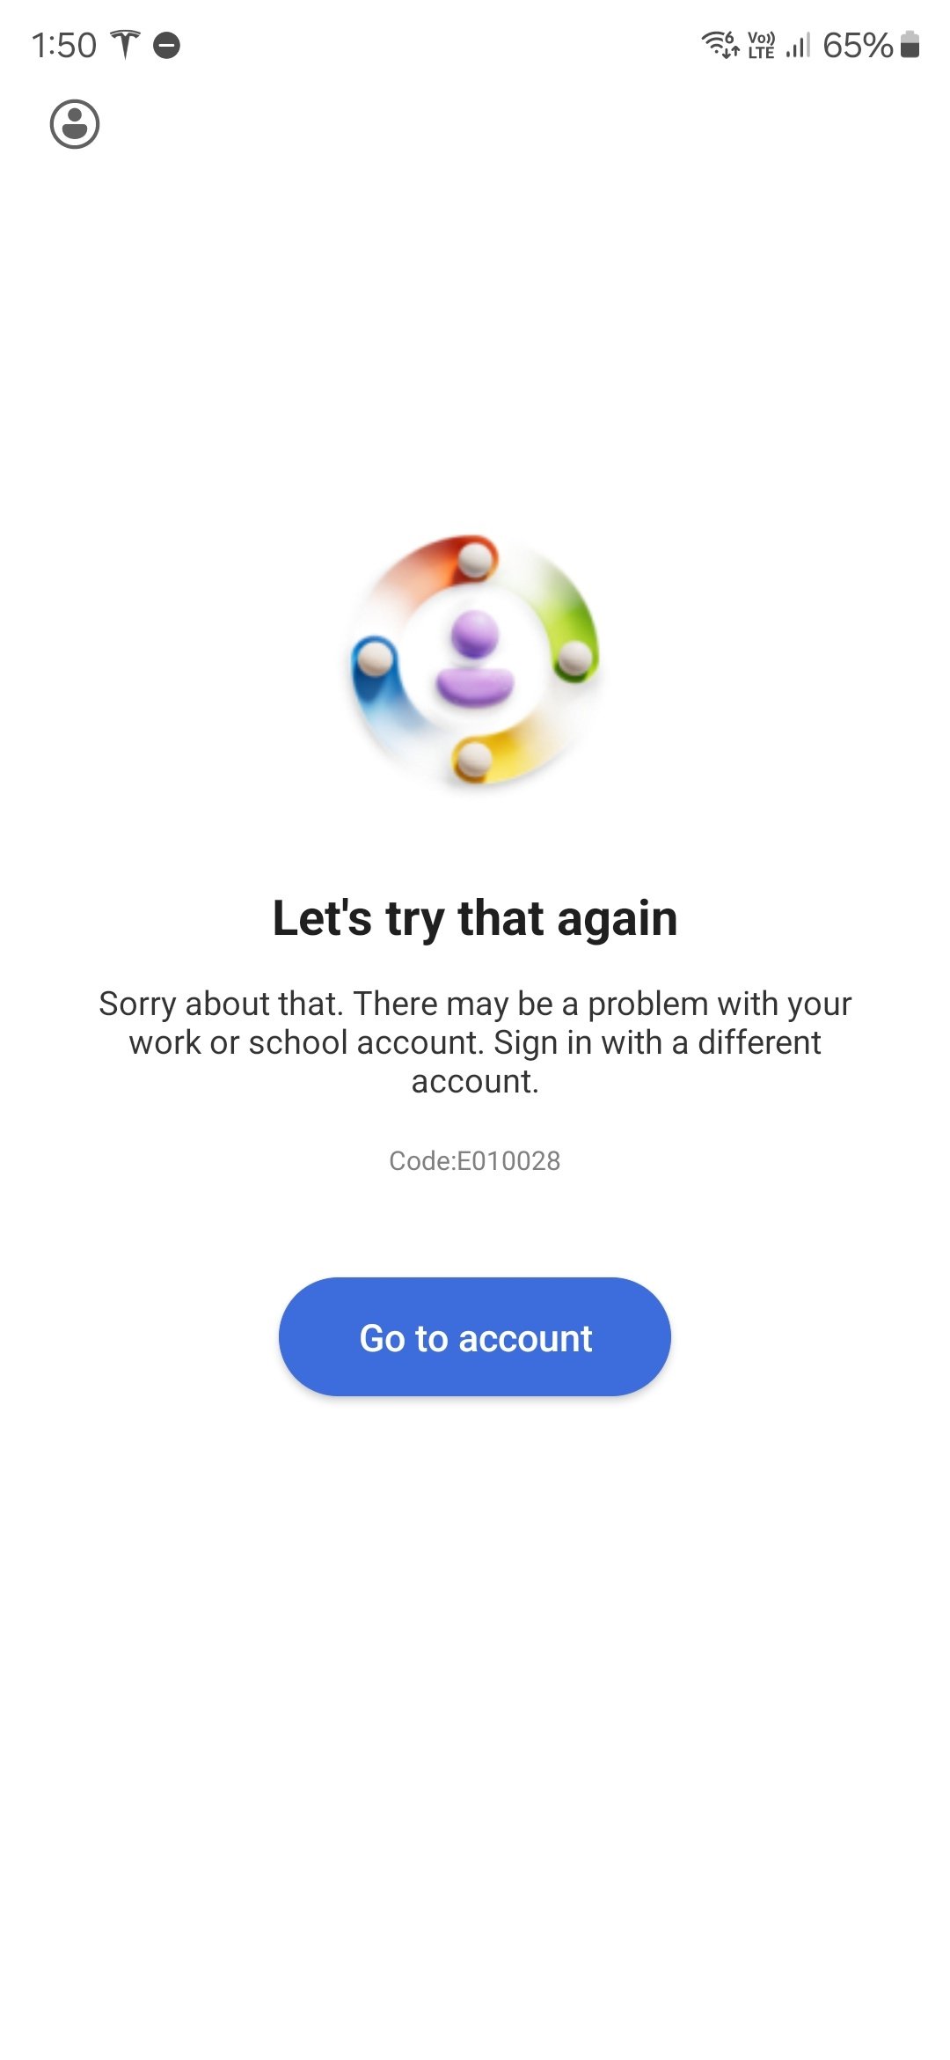
Notes:
I can’t wait to have a whole team of AI engineers. They might still not do what I want, but at least I can just reboot them when I get annoyed. Or. in the case of CoPilot, I can just wait for it to hang up on itself.

Slide 10
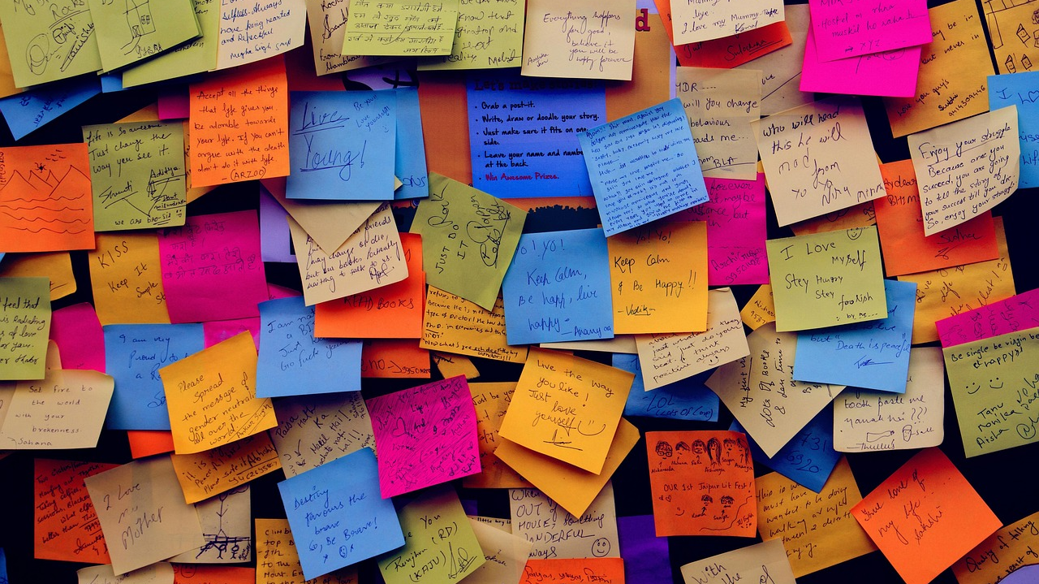
Notes:
Next, let’s talk about customers! Building a service would be so much easier if we didn’t have all these customers. They take up so much of my time, that I could be spending on making our SCRUM board look nice!

Slide 11
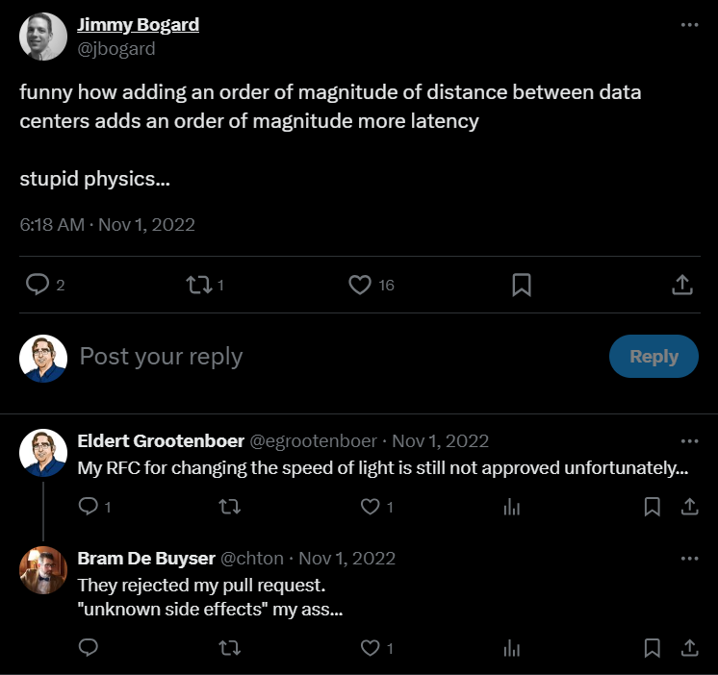
Notes:
For example, we are building a geoDR feature, and now I have explain my customers that, NO, we can not give you 10 milliseconds latency between Australia and Europe! I tried to put in the pull request to break the speed of light, but apparently, we are not allowed to change the laws of physics.

Slide 12
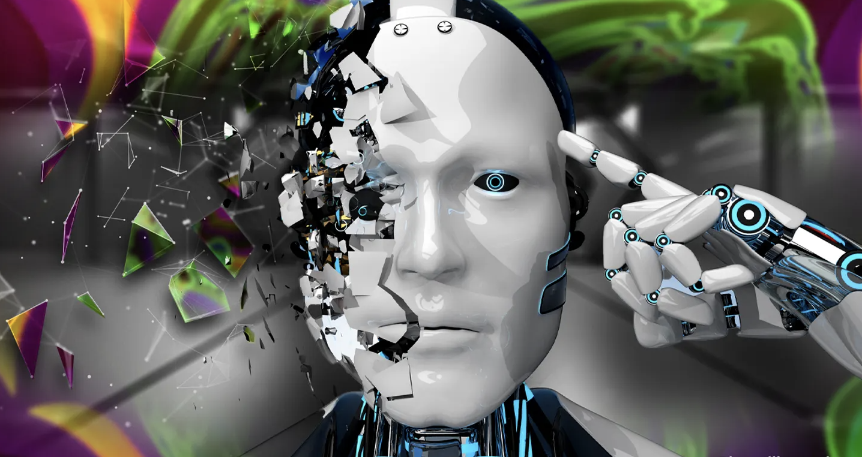
Notes:
Another great pastime of mine is getting on a customer call because they have seen a 5 second hiccup, and now they want to get a 70 page RCA, signed by Satya himself. Let’s replace all our customers with AI, so at least I know I can expect them to be hallucinating.

Slide 13
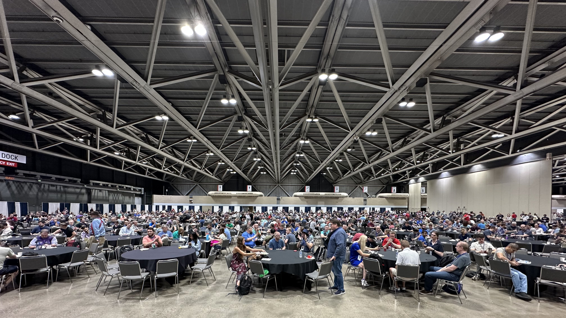
Notes:
And of course, then there is the community. Yes, that means all of you! You didn’t think you would get away so easily, now would you? I have a comment or two for all of you as well, now that we are here together.

Slide 14
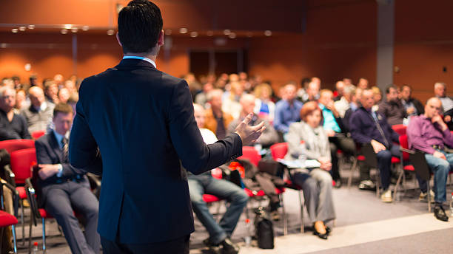
Notes:
First of all, as a speaker, there is nothing just like spending weeks on building a session, doing dry runs, fly over half the country or even world, spend an hour on stage giving all our best. And then, when it’s time for you to provide your feedback…

Slide 15
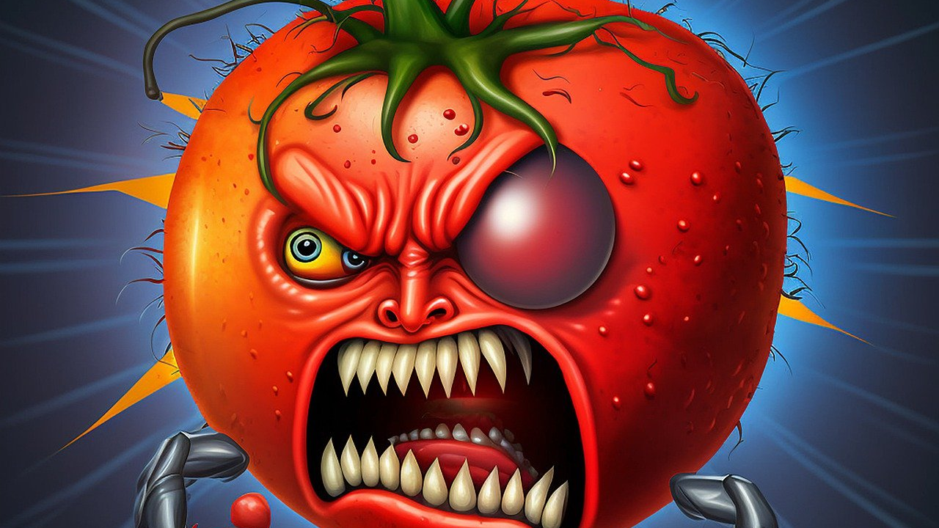
Notes:
You give a negative rating because the temperature is not right! Look, I can’t help that the organizers decided to run this event on the surface of the sun. There is enough in my session for you to complain about without resorting to complaining about the climate.

Slide 16
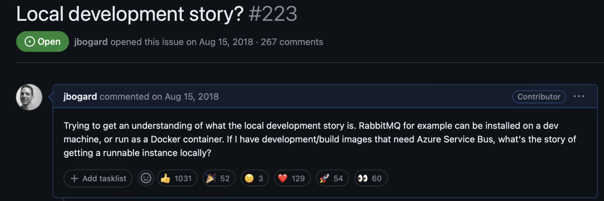
Notes:
And why do you all think you can keep asking us for features that would make sense? Don’t you know I have Power BI reports to build? I don’t have time to look at these! Go build some more open source products and leave me alone.

Slide 17
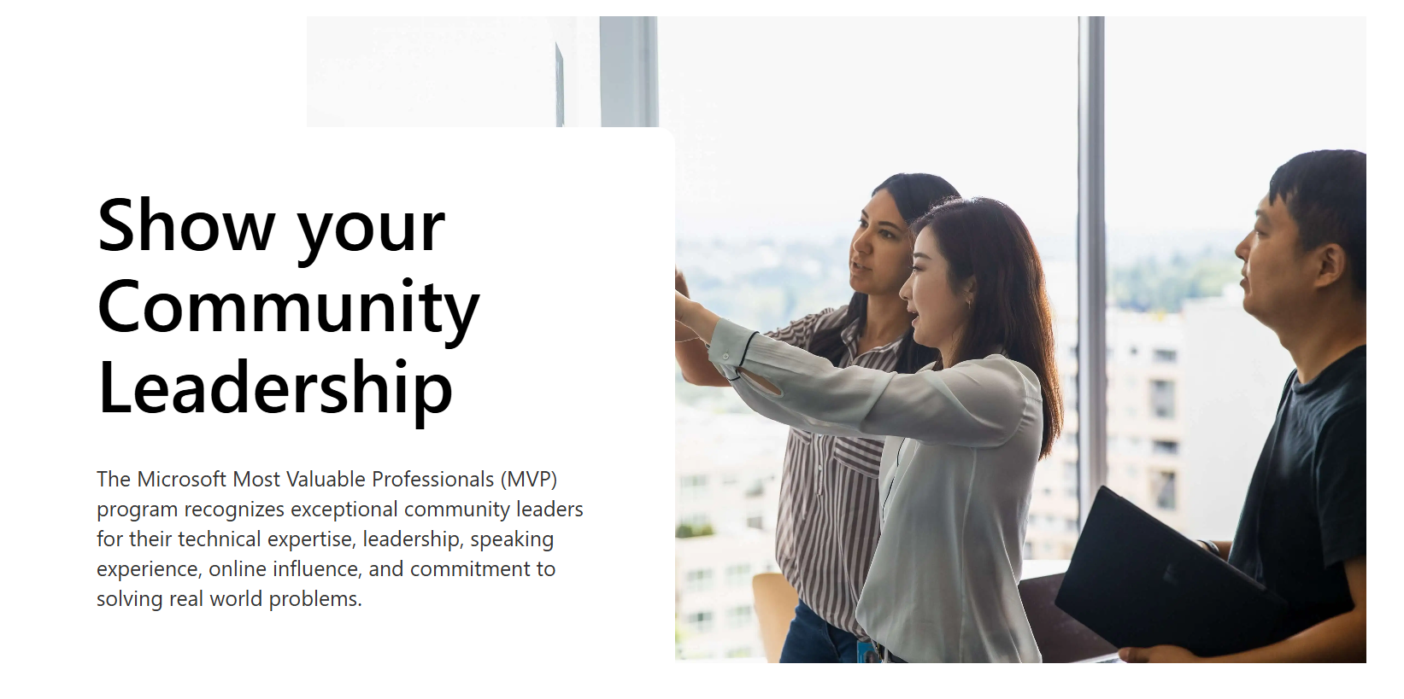
Notes:
Okay, don’t get me wrong, I do love our community. And, as Microsoft, I especially love our MVPs. I get to ask them for feedback, run meetings for them, and share NDA information with them.

Slide 18
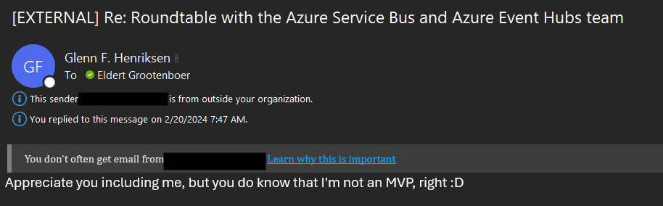
Notes:
And then they have the audacity to tell me that they are not even an MVP! This is just so rude Glenn, me sharing all this amazing content, and then finding out that you’re not even allowed to hear about it!

Slide 19
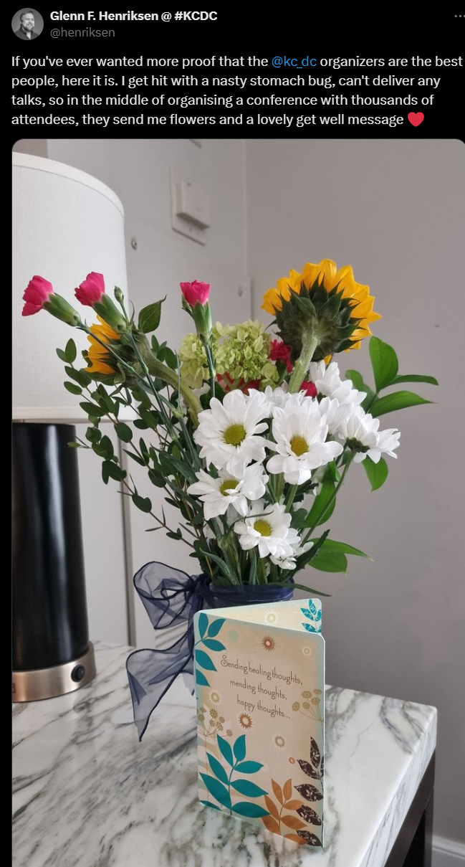

Slide 20
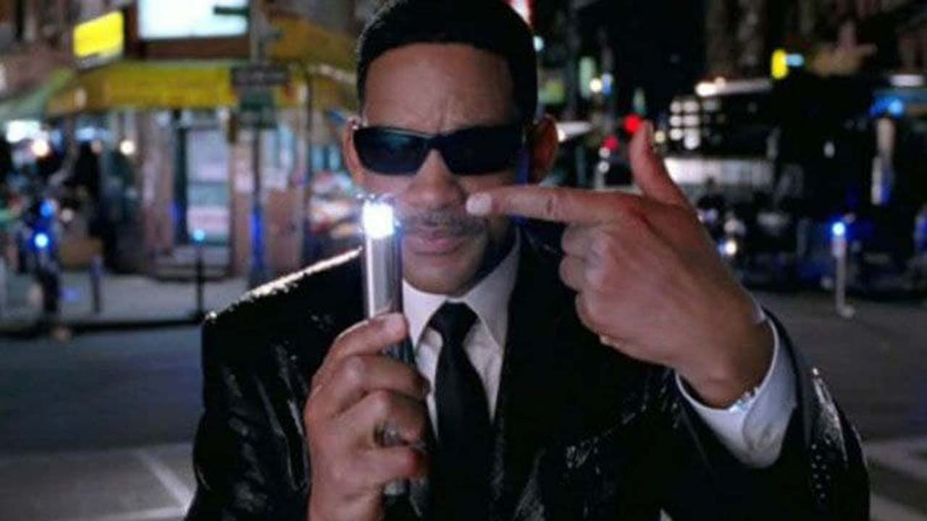
Notes:
So now I have to go all Men in Black on him and erase his memory… Now, I don’t have a flashing light to erase any memories, but I do have other ways to make people forget things.

Slide 21

Notes:
Which reminds me, Glenn, can you please order a couple of drinks for the both of us? You look like someone who can handle a couple of shots. And you can forget about al these new amazing features I told you about.

Slide 22
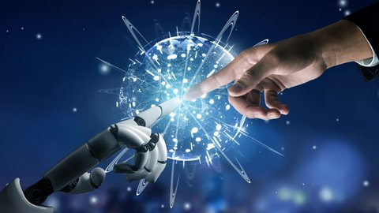
Notes:
And this is why I can’t wait for AI to take over. By the way, you might be thinking, am I not afraid, that AI will take over my job? Nah, because for AI to take over, there has to be some intelligence needed for the job first! Thank you!

